Slide 1


Slide 2
Year
in
Review
2019

Slide 3
'19
Over the past year, our company has experienced tremendous growth and success, and it wouldn't have been possible without our valued customers. Their unwavering support, trust, and loyalty have played a pivotal role in shaping this remarkable year.
As we reflect on the past year, we are immensely grateful for the strong relationships we have built and the incredible journey we have embarked upon together. Our customers have truly been the cornerstone of our success.
Summary

Slide 4
Changes
We've Seen
TRENDS
The rapid sales growth across major areas reflects the dynamic nature of today's markets. These insights help us better understand the current business environment, and indicate that our product is in demand more than ever.
+15%
+25%
45%
Premium Grade Equipment
Online Sales
Mobile Commerce
Consumers increasingly prioritize quality over price in their purchases.
The retail market has grown significantly as individuals embrace online shopping.
More than half of e-commerce sales are from mobile devices, highlighting the importance of optimized shopping experiences.

Slide 5
Performance
+31%
Social Engagement
+31%
Adoption
+27%
CSAT
+23%
Revenue
+18%
Signups
+10
Team Members

Slide 6
Performance Overview Highlights
Income Growth is flat
Less goods sold
Increase in Average Income Per Sale
 | Last Financial Year (April 2018 – May 2019) | Current Financial Year (April 2019 – May 2020) | Percentage Change
Income | 1.35L | 1.36L | + 1.0%
Number of sales | 2257 | 750 | -66.8%
Average Income Per Sale | 599 | 1,819 | +203.9%

Slide 7
Performane Overview

Slide 8
Performane Overview

Slide 9
Performane Overview

Slide 10
Performance – Average Income Per Sale

Slide 11




Moments
Worth Celebrating
Most sold equipment
Adjustable 20kg dumbbells set with 3ft curl bar
Most common request
Adjustable benches
Month with most sales
FEBRUARY.
Most liked social post
Video showing different workouts possible with adjustable dumbbell set
Notes:
Anecdotes: Fun highlights and tidbits from the year — the most used feature, the most liked social post, the most common request or question to support etc. Key learnings or takeaways to consider next year.

Slide 12
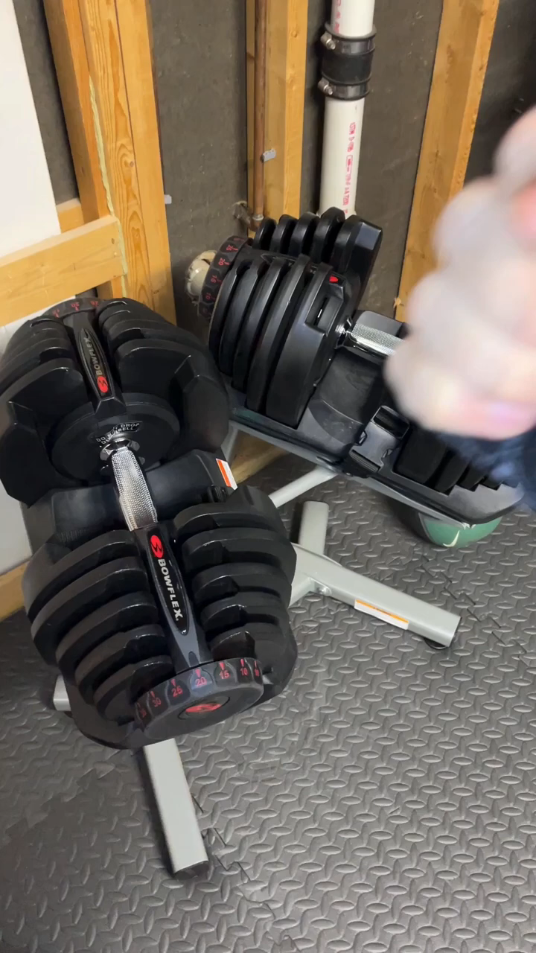
Moments
Worth Celebrating
Most liked social post
Video showing different workouts possible with adjustable dumbbell set
Notes:
Anecdotes: Fun highlights and tidbits from the year — the most used feature, the most liked social post, the most common request or question to support etc. Key learnings or takeaways to consider next year.

Slide 13
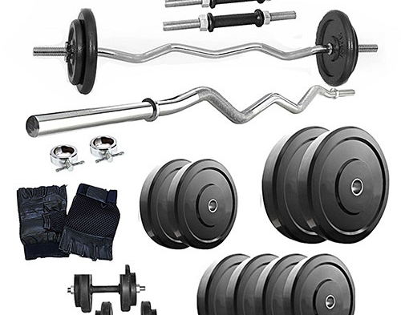
Moments
Worth Celebrating
Most sold equipment
Adjustable 20kg dumbbells set with 3ft curl bar
Notes:
Anecdotes: Fun highlights and tidbits from the year — the most used feature, the most liked social post, the most common request or question to support etc. Key learnings or takeaways to consider next year.

Slide 14
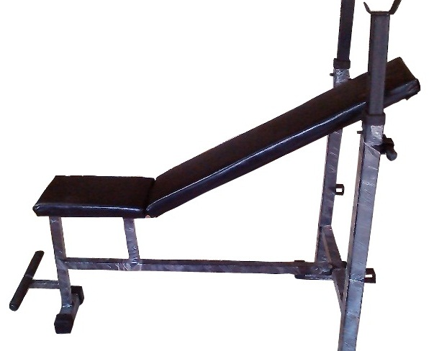
Moments
Worth Celebrating
Most common request
Adjustable benches.
ADJUSTABLE BENCH
Notes:
Anecdotes: Fun highlights and tidbits from the year — the most used feature, the most liked social post, the most common request or question to support etc. Key learnings or takeaways to consider next year.

Slide 15
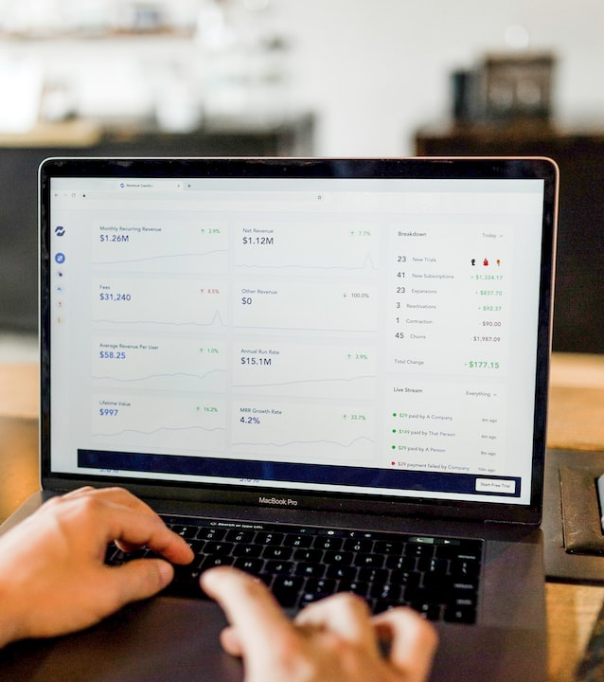
Moments
Worth Celebrating
Break up of month with most sales
FEBRUARY
Equipment
Treadmills
Dumbbells
Bars
Fitness bands
Weights
Notes:
Anecdotes: Fun highlights and tidbits from the year — the most used feature, the most liked social post, the most common request or question to support etc. Key learnings or takeaways to consider next year.

Slide 16
NEW Customer Reach-out

Slide 17
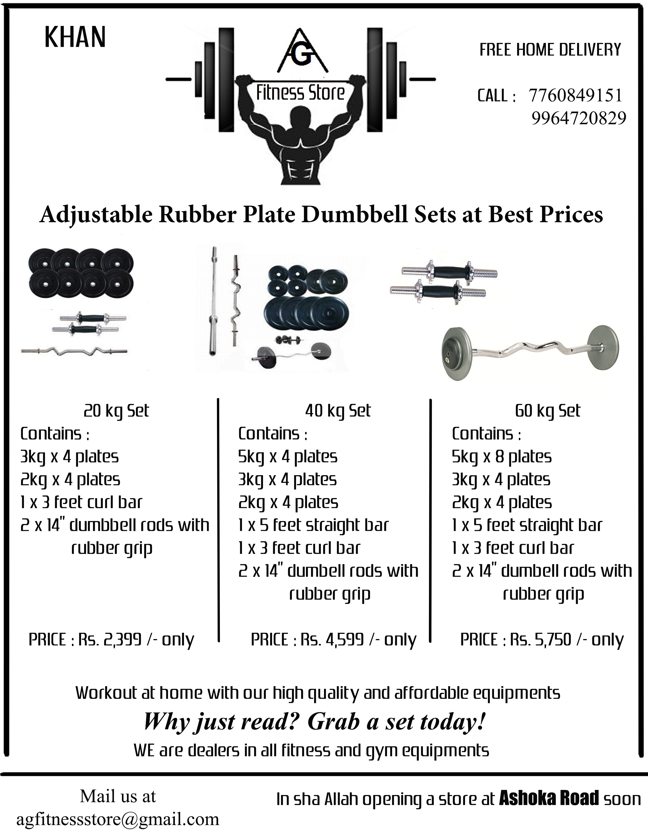
Door to door campaign
New Customers

Slide 18
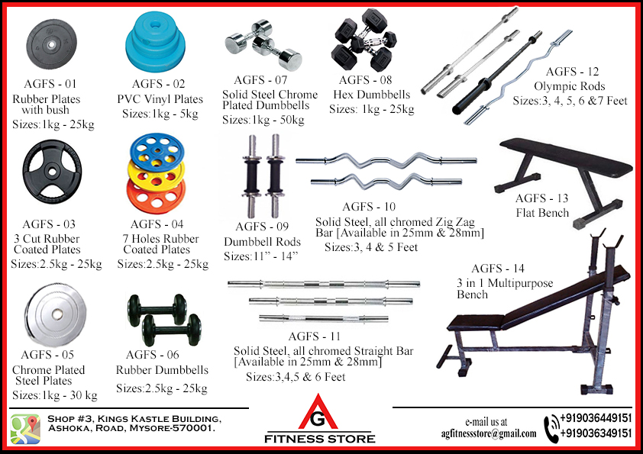
Fresh catalogue
New Customers

Slide 19
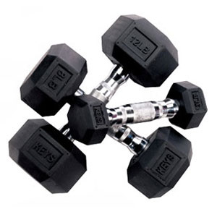
Changes
We've Made
With Website Sales, we're enhancing retail experience.
Personalized recommendations
Seamless payment process
Exclusive discounts and offers
Contactless payment options
What's great about that?
It makes every shopping trip an effortless delight.

Slide 20
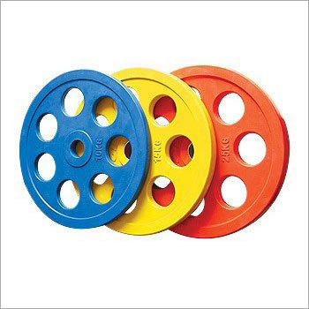
Changes
We've Made
With Website Sales, we're enhancing retail experience.
Personalized Recommendations
Exclusive Discounts
and Offers
Contactless
Payment Options
Our your shopping history and preferences to offer real-time, hyper-personalized product recommendations.
Enjoy special discounts, offers, and loyalty rewards tailored to your preferences.
We support a variety of contactless payment methods, including digital wallets.
What's great about that?
It makes every shopping trip an effortless delight.

Slide 21
Changes
We've Made
CUSTOMIZATION
VISUAL DESCRIPTION
Description or visual of notable new products / services, features, and improvements from the past year.
Customizable metal thickness, size,
weight
Significance for the market or customer(s)
Significance for the market or customer(s)

Slide 22
What
They're Saying
Customer Reviews

Slide 23
What
They're Saying
‘Like the option of customizing the fitness bench. Can add leg curl and bicep curl, which is great.’
(Mr. Salman)

Slide 24
What
They're Saying
‘Quality of the dumbbells is the best.’
(Mr. Pavan)

Slide 25
What
They're Saying
‘The website purchasing is a game-changer, and I can't imagine shopping without it!’
(Mr. Murthy)

Slide 26
Timeline
Expand Online
Sustainability Initiatives
New Store Interiors
Successfully expanded our
e-commerce operations, increasing our online product catalog by 30%.
Reduced our carbon footprint by 20% through eco-friendly packaging and energy-efficient stores.
Better display of products and access to try equipment
Launch of
Website
Customer Loyalty Program
Introduced seamless checkout, personal recommendations.
Increased customer retention by 15% and provided personalized offers.
Q1 January
Q2 April
Q3 July
Q4 October

Slide 27
Biggest
Stat
1,251
ONLINE ORDERS

Slide 28
Biggest
Stat
2,118
New Customers

Slide 29

Achievements
+3.45L
63%
Revenue
Increased Sales
AWARD
AWARD
AWARD

Slide 30




Additional
Highlights
Mobile
Storefront
Introduced regular app updates, including improved navigation, faster loading times, and a more user-friendly interface.
Conducted minor store layout adjustments based on customer feedback, enhancing in-store navigation and making it easier to locate products.
Customer Support
Payments
Extended customer support hours to offer assistance from 7:00 AM to 10:00 PM, accommodating a wider range of customer schedules.
Added support for additional payment methods, such as digital wallets, making it even more convenient for customers to complete their purchases in-store or online.

Slide 31
Next
Year
Q1
Q2
Q3
Q4
Mantri Fitness Club
EVENTS
Beast Gym
Lilac Hotel Gym
DX Fitness Centre
EVENTS
Launch Event Plan
OKR Scoping
Global OKR Updates
EVENTS
Finance Business Year Close
Pulse Survey
Holiday Party Planning
EVENTS
Team Retreat
Year in Review

Slide 32
Thank you

